Slide 1

Chile: Best comuna to place a Coffee shop
A Data Science project

Slide 2

Introduction/Business problem
I live in Chile and also love coffee. I've always dreamed about putting a Coffe shop somewhere, but of course the question that arise immediately is "where?". Here, I'll try to answer that question by using some of the techniques learned on this IBM Data Science courses.
Chile is subdivided on Regions and Comunas, being this Comunas as large Neighborhoods. Please, keep in mind that.
I’ll focus on the Metropolitan region: is the one with most population and incomes, and the best IDH ratings.

Slide 3
Data Description
A Wikipedia page where is the info I need: Latitude and Longitude for each Comuna in Chile, divided by Region. The page is the following: https://es.wikipedia.org/wiki/Anexo:Comunas_de_Chile
Also, on this table, there are two more indicators tha will help me on my analysis: the Population Density (Habitants/Km^2) and the IDH (Indice de Desarrollo Humano or Human Development Index). The Density will help me to know and approximate of how many Coffee shops per habitant are there, and the IDH will help me to choose the Comuna with better incomes, since one of the indicators for that number is precisely that one. Also, the comunas with better IDH have better infraestructure, more educated habitants and more tourism, which is better for a Coffe shop.
I'll also use the foursquare data to get, by comuna, the most common venues and then, by using K-means algorithm, group the comunas and choose the one that looks best to place the Coffee shop. Then, I'll work with the most representative group and get the number of Coffee shops existant (using again Foursquare data), get the number of coffee shops per habitant and with that number, choose the best comuna to place my shop.

Slide 4
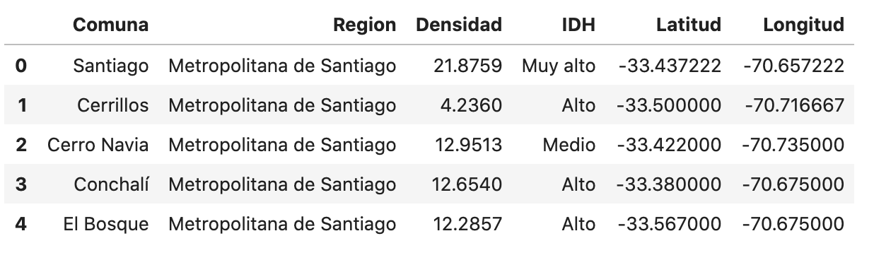
Methodology
First, we get the table from the site mentioned above and we clean it a little bit, in order to finally have this:

Slide 5

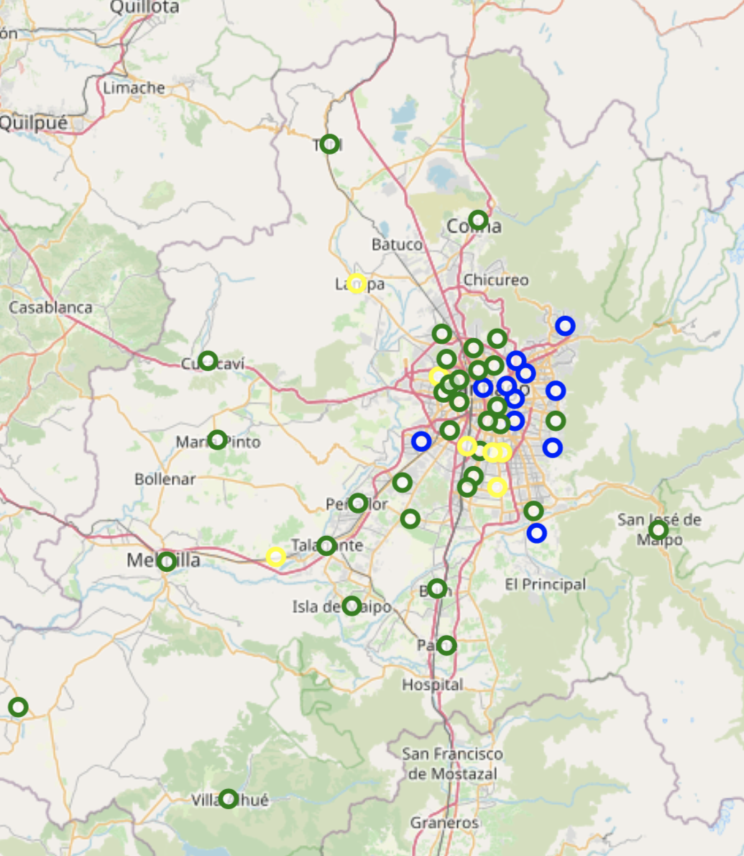
Check the map
In Blue, are the comunas with Very High IDH
In Green, the ones with High IDH
In yellow, the ones with Medium IDH

Slide 6
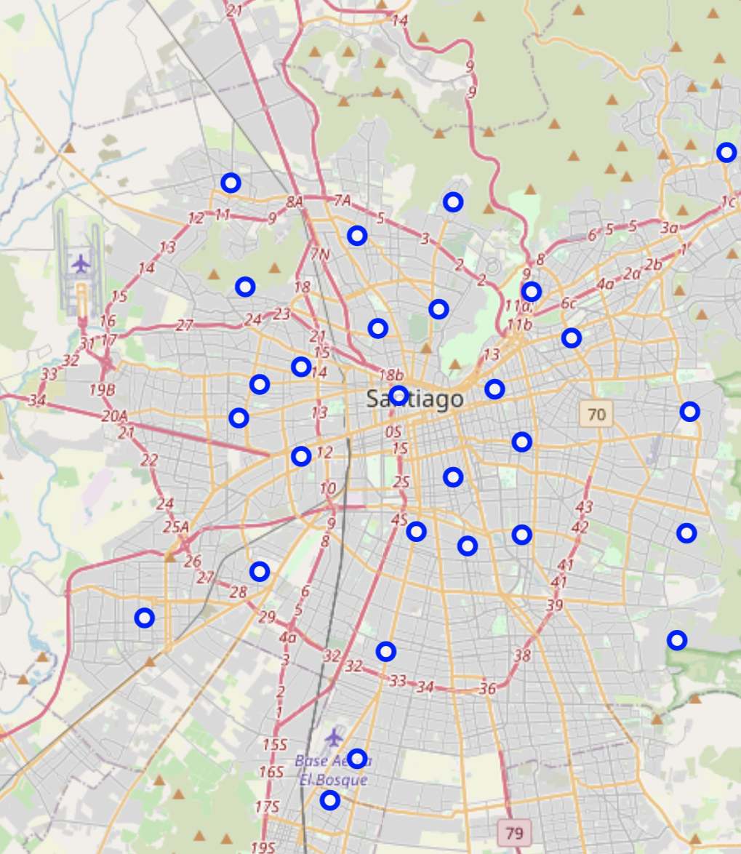
Looks good, but there are too many Comunas. Let’s cut down the amount: - we’re going to left the comunas near to the center of the Region and the ones with IDH ‘High’ or ‘Very high’.

Slide 7
Methodology
Ok, so we got 28 out of 52 comunas to analyse further.
Let’s use the Foursquare data to get the 10 more common venues for each Comuna

Slide 8
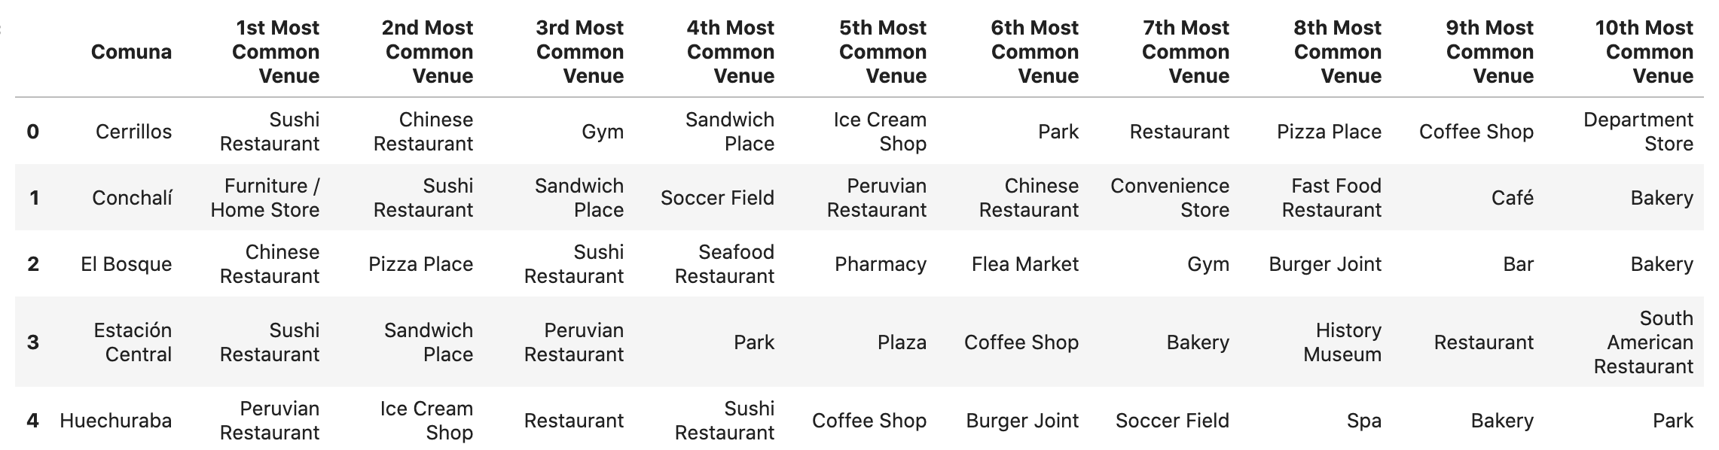
10 most common venues for Comuna

Slide 9

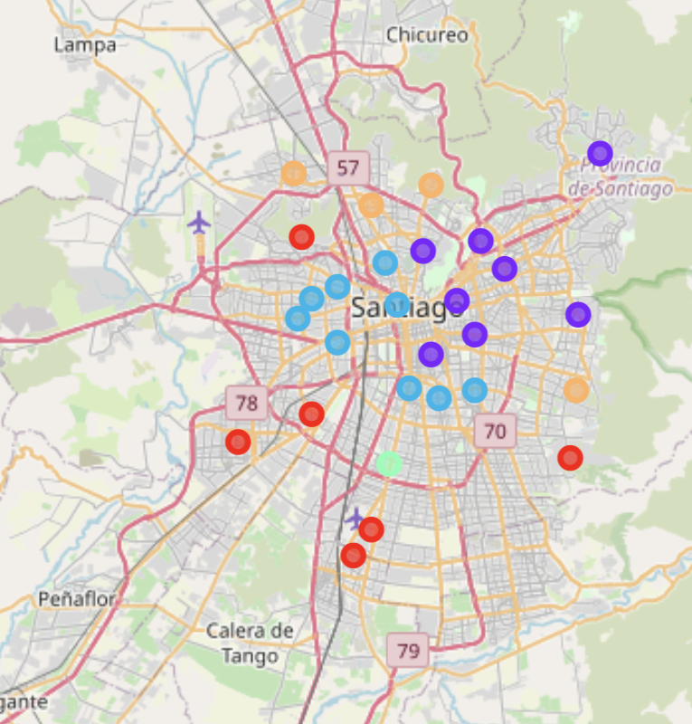
K-means grouping
With that data, we will use K-means algorithm to group the comunas and select the one who looks more suitable for us.
This is what it looks like after applying the algorithm and visualize the results on the map.

Slide 10
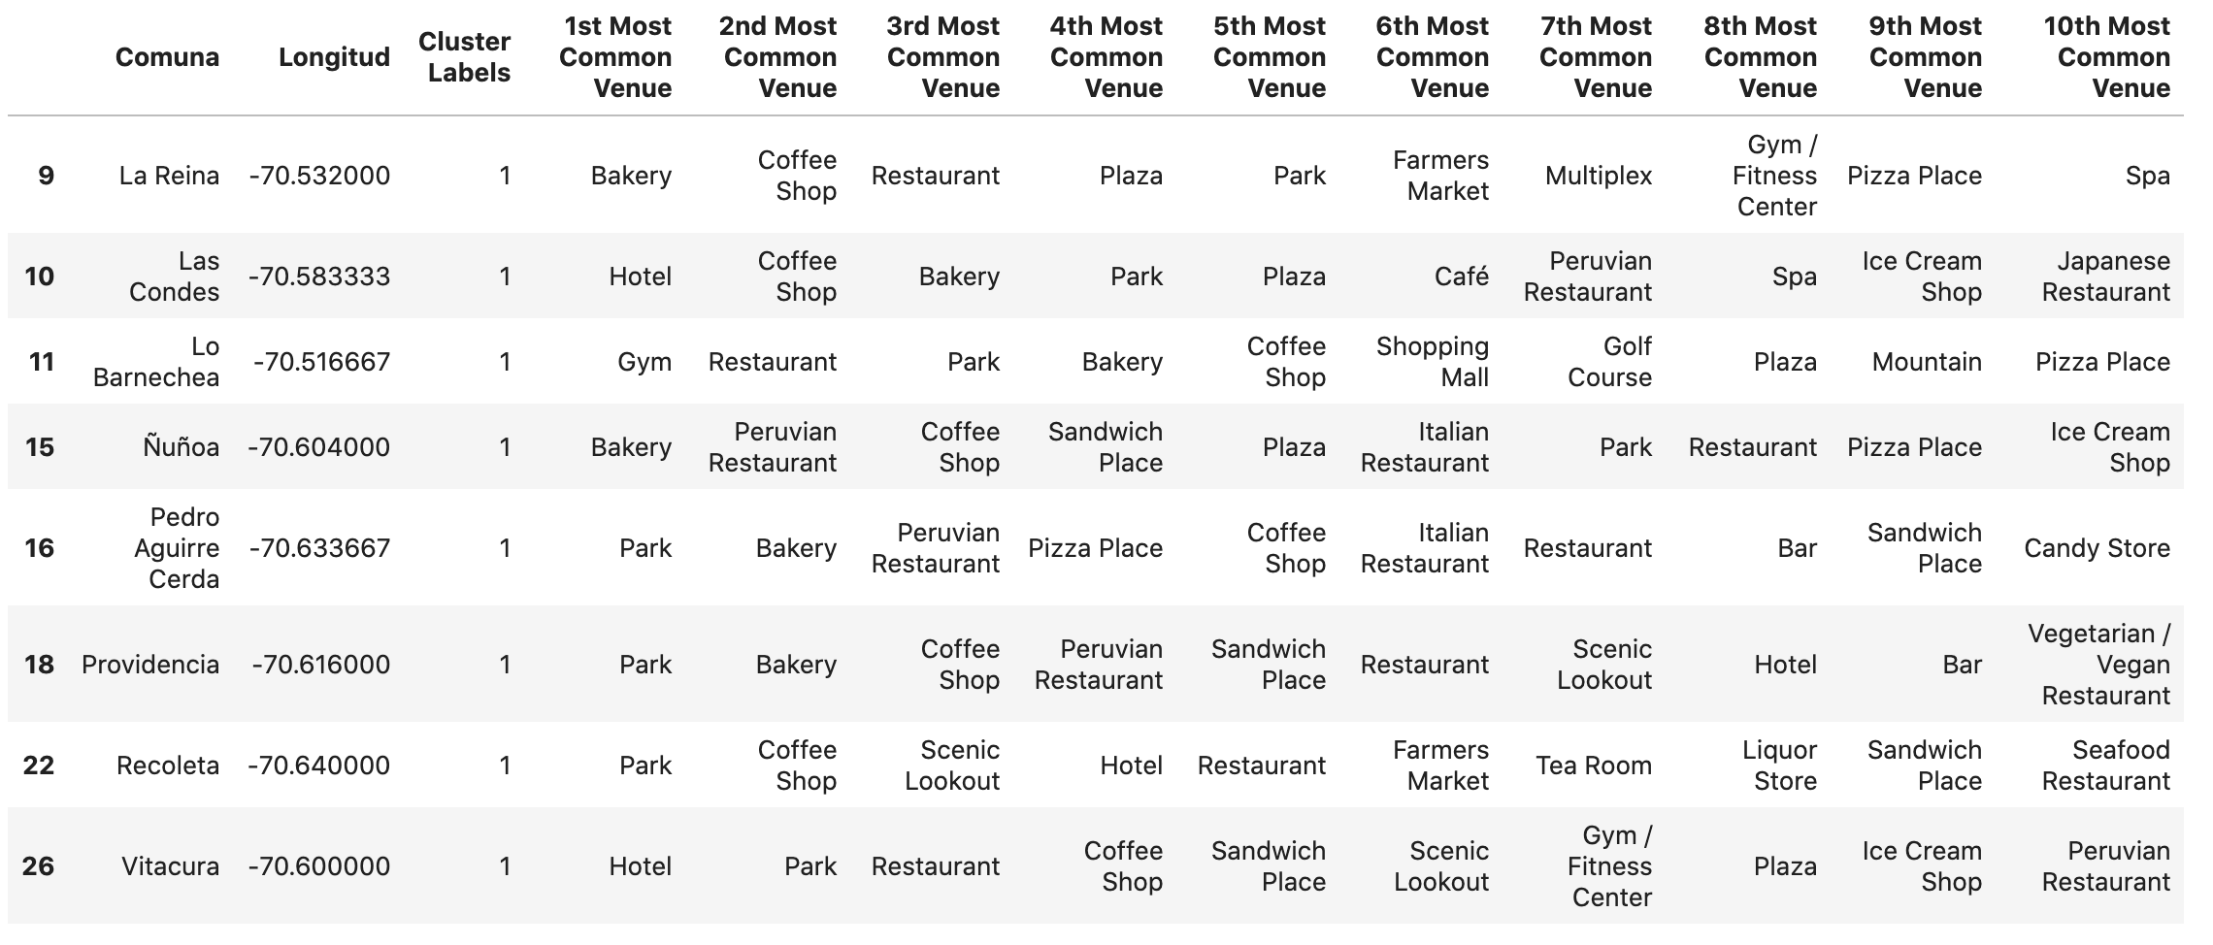
Cluster 1, the most promissing one

Slide 11
Cluster 1 is the selected
This is the most interesting cluster, where all the comunas have a Coffee Shop on the top 5 most common venues. Also, we see a lots of Bakery shops and nonetheless, parks and gyms, where our target audience usually hangs out.

Slide 12
How can we select the best Comuna in the cluster?
Lets find out which of the Comunas in the cluster is the best.
One way to do this is to get how many Coffee shops are there, and then divide this number by the population density and we get the approximate Coffee shops per habitant.
The Comuna with the lowest number will be the one!

Slide 13
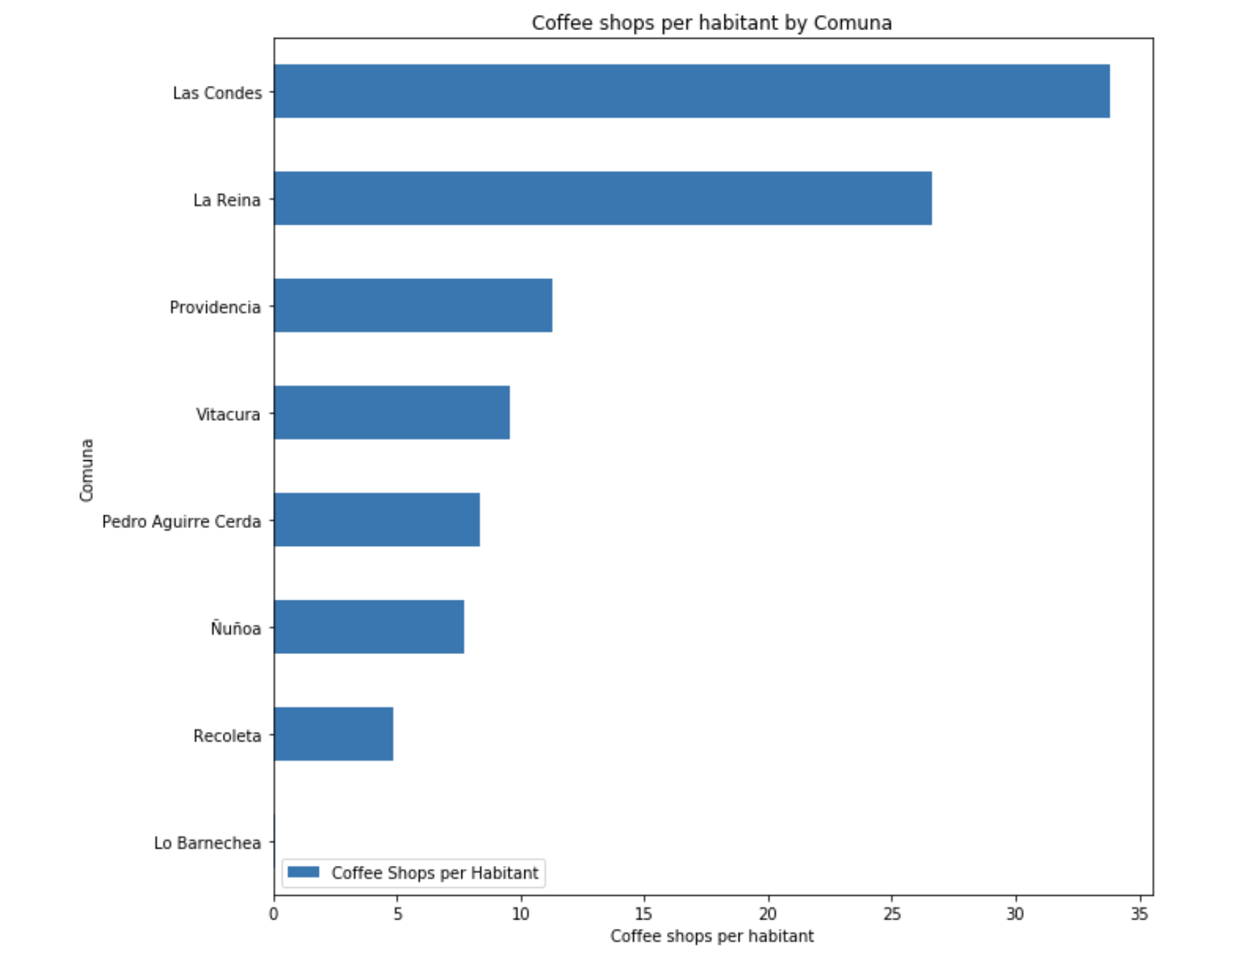
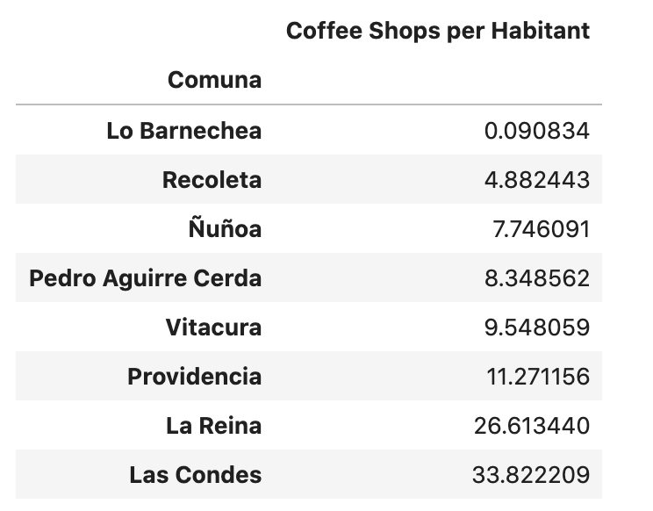
Results

Slide 14
Conclusion
After all the analysis ran on this set of Data, we can say that the best comuna to place our Coffee shop business is Lo Barnechea, since the amount of Coffee shops per habitant is surprisingly low in comparission with the other comunas on the same cluster.
Nowing a little bit abot the Comunas of the Region Metropolitana, I can say that this resuls are good enough, because on this case, Lo Barnechea has more or less the same incomes than the other comunas on the same cluster, like Las Condes or Vitacura, and the population on this Comunas are likely to share the same interest. Also, it has an IDH of 'Very high', so it's a good candidate enough. The exact location of the place is, of course, something to analyze further.

